Slide 1
Creating Student Built Review Pages In Canvas
Featuring the New RCE

Slide 2
Today You Will Learn…
How Canvas Pages can be used to create digital posters for a collaborative review activity in which your students work together to build out review pages that will be available for all students in a course to see.
Additionally, by completing this walk through, you will get the chance to try out the new Rich Content Editor in Canvas

Slide 3
Agenda
Review Standard: Knowledge Constructor
Pedagogical Connection: Collaborative learning through formative peer review
Walkthrough of Activity Build Using Canvas
Build Your Own

Slide 4
Knowledge Constructor
Students critically curate a variety of resources using digital tools to construct knowledge, produce creative artifacts and make meaningful learning experiences for themselves and others
  A. plan and employ effective research strategies to locate information and other resources for their intellectual or creative pursuits.
  B. evaluate the accuracy, perspective, credibility and relevance of information, media, data or other resources.
  C. curate information from digital resources using a variety of tools and methods to create collections of artifacts that demonstrate meaningful conclusions.
  D. build knowledge by actively exploring real-world issues and problems, developing ideas and theories and pursuing answers and solutions.

Slide 5
Collaborative Learning Through Peer Review
In this jigsaw, students work together to create a Canvas page of review materials and resources available to all students in the course.
Students demonstrate understanding of learning
Students work together to support other students learning

Slide 6
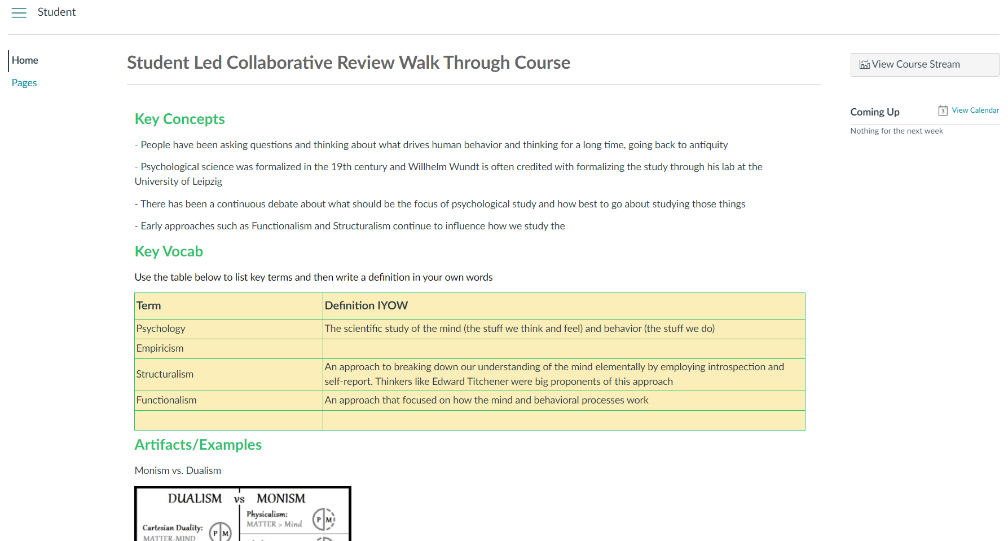
Walk Through of Activity Build
Click on the picture to see an example of what we will build today (must be in slideshow mode)
Notes:
Here’s the link: https://issaquah.instructure.com/courses/11016
Be sure to click on the pages link to see how a teacher can quickly scale the activity using the duplicate button

Slide 7
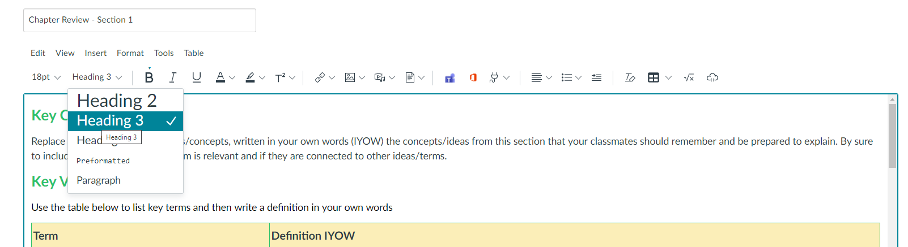
Set Up a Template Page
Create a new page (Pages > All Pages > + Page button)
Add your first header and then add directions underneath
Highlight the header and change Paragraph to Heading 3

Slide 8
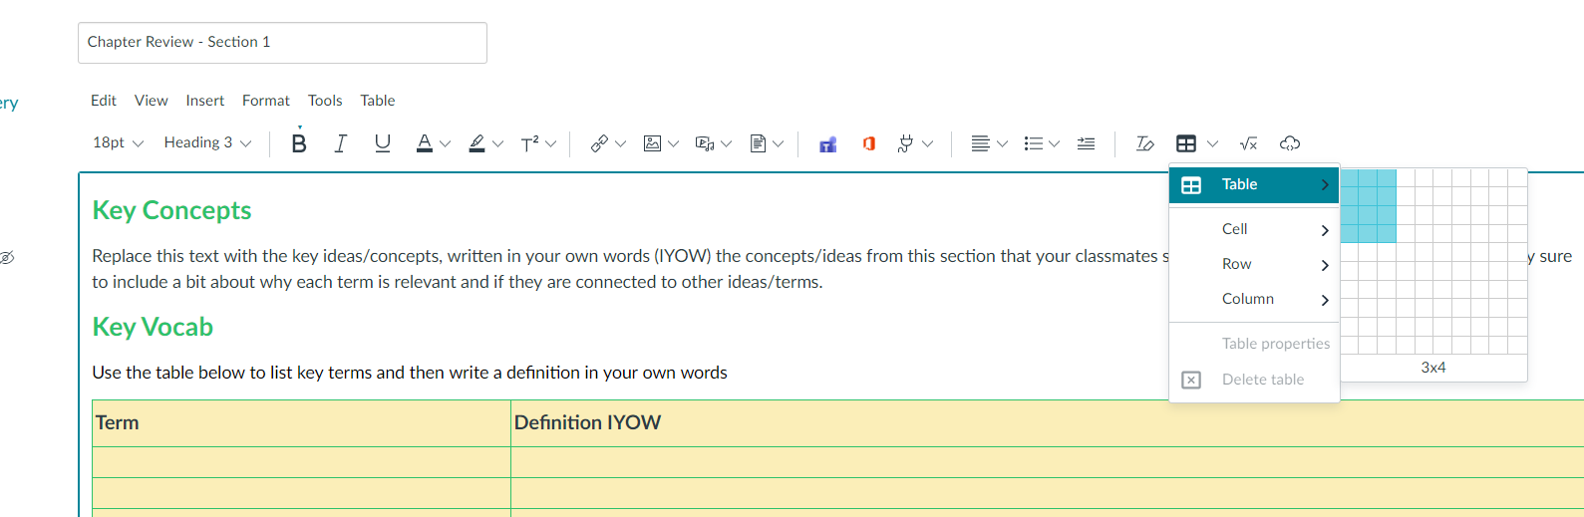
Set Up a Template Page Cont.
Add your second header and directions for adding to the table
Insert Table

Slide 9
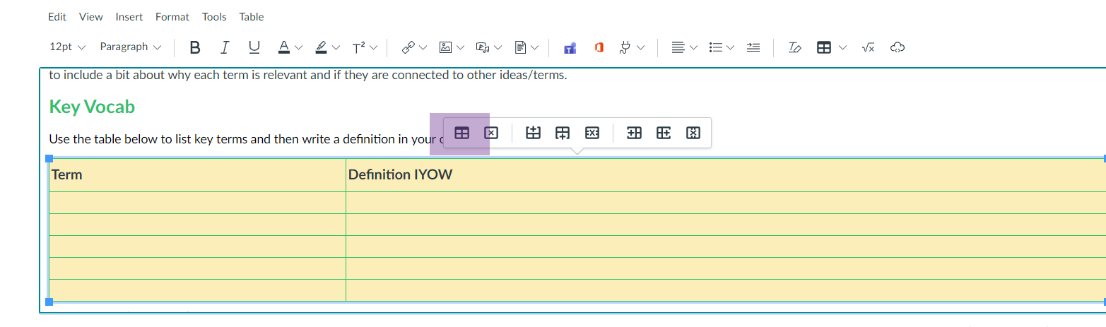
Set Up a Template Page Cont.
Change the color scheme of the table by clicking on the table and choosing Table Properties from the menu that pops up (first box) This will open a window to make changes

Slide 10
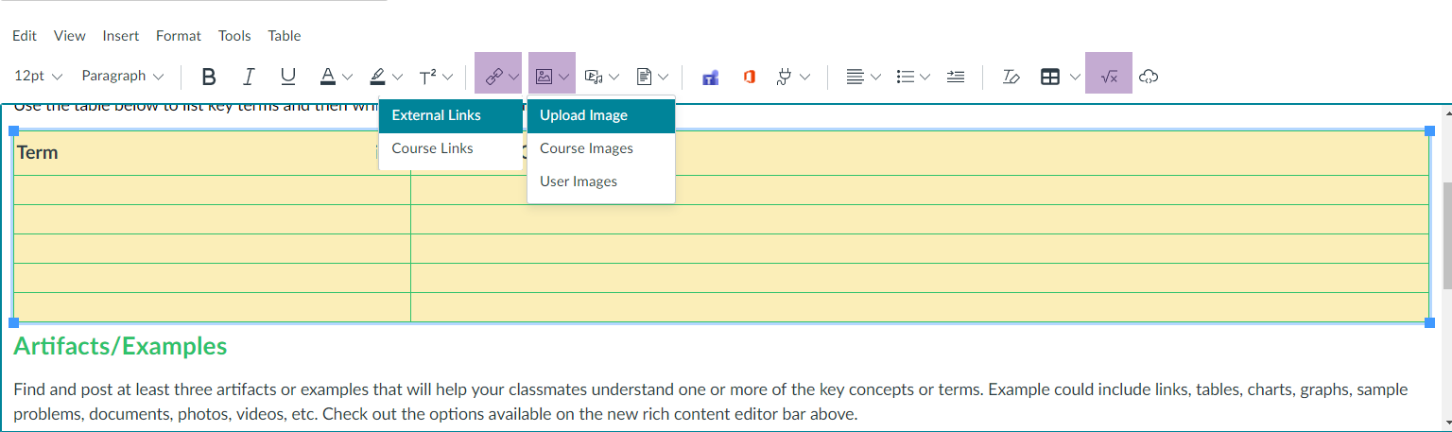
Set Up a Template Page Cont.
Add more sections (e.g.- Artifacts, Links to More Resources, etc.)
Try adding a picture, inserting a link and adding a formula

Slide 11
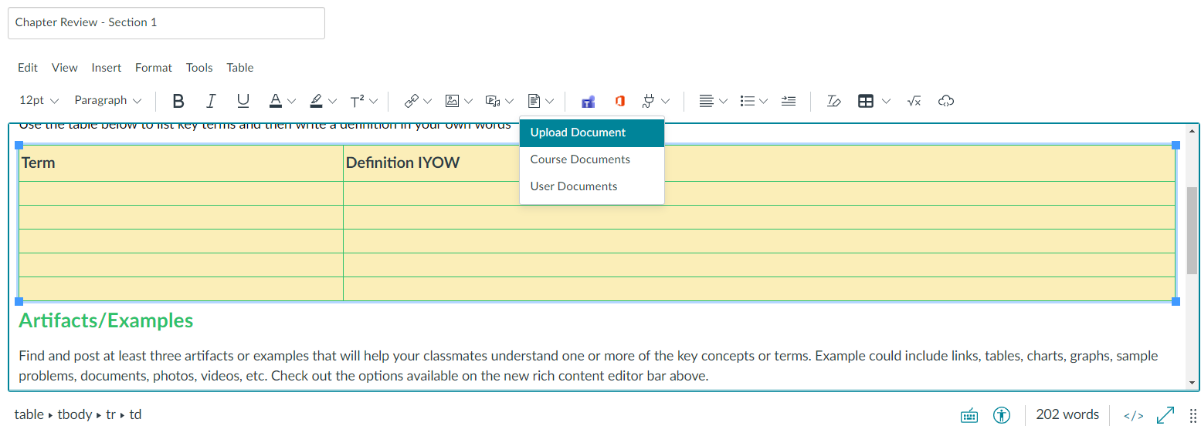
Set Up a Template Page Cont.
Now add a document to the page by clicking on the document button

Slide 12
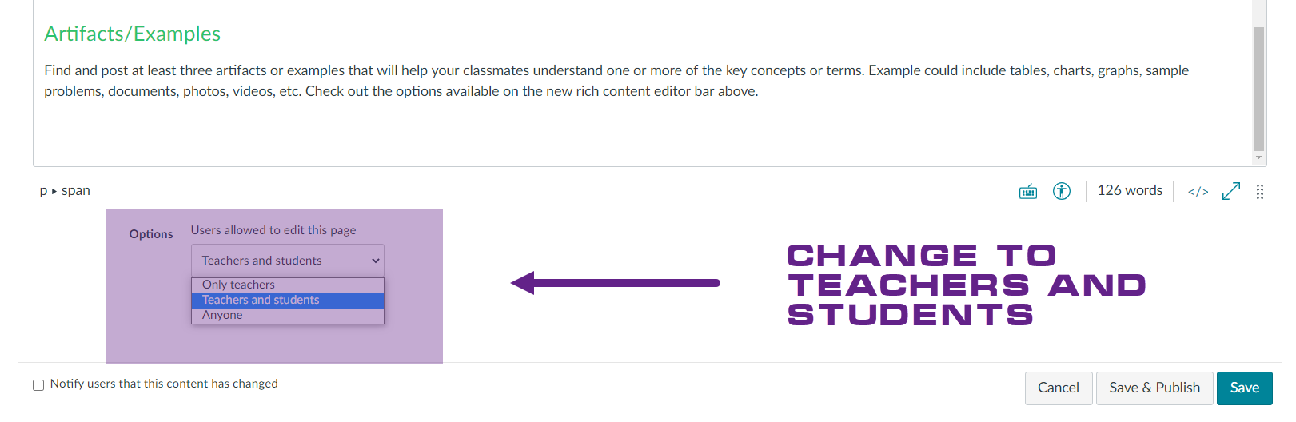
Set Up Pages for Students to Edit

Slide 13
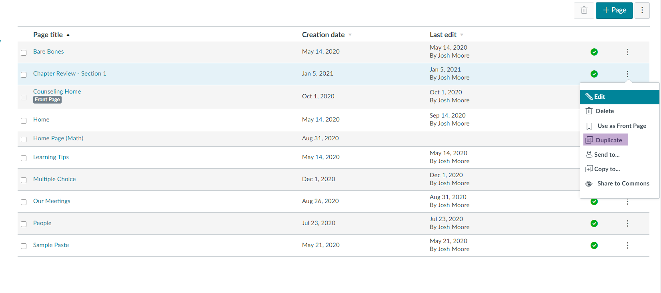
Duplicate That Page

Slide 14
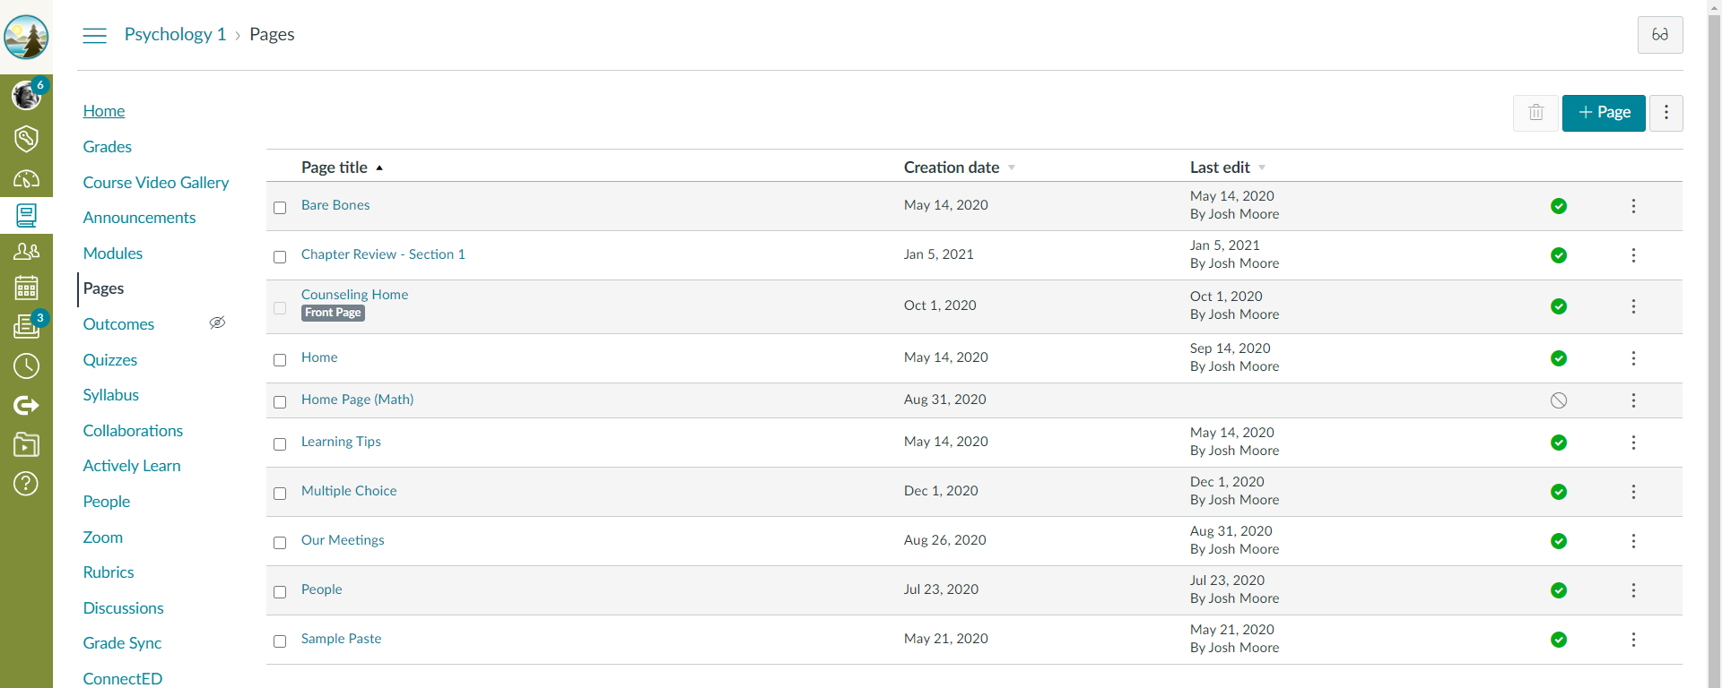
Make Sure You Published Those Pages

