Slide 1
ACTIVELY LEARN
STUDENT SIGN-UP

Slide 2
GETTING STARTED
Visit Activelylearn.com
Choose Student Sign-Up (or Sign-In)
Wait

Slide 3
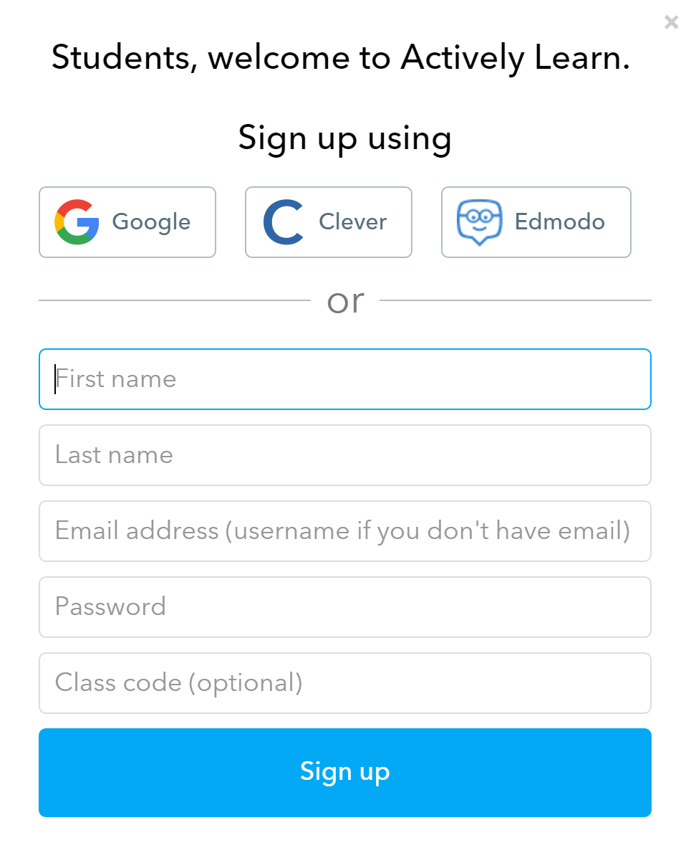
SIGN-UP
Fill In:
First Name
Last Name
Username (email optional)
Password

Slide 4
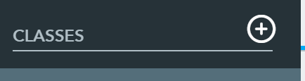
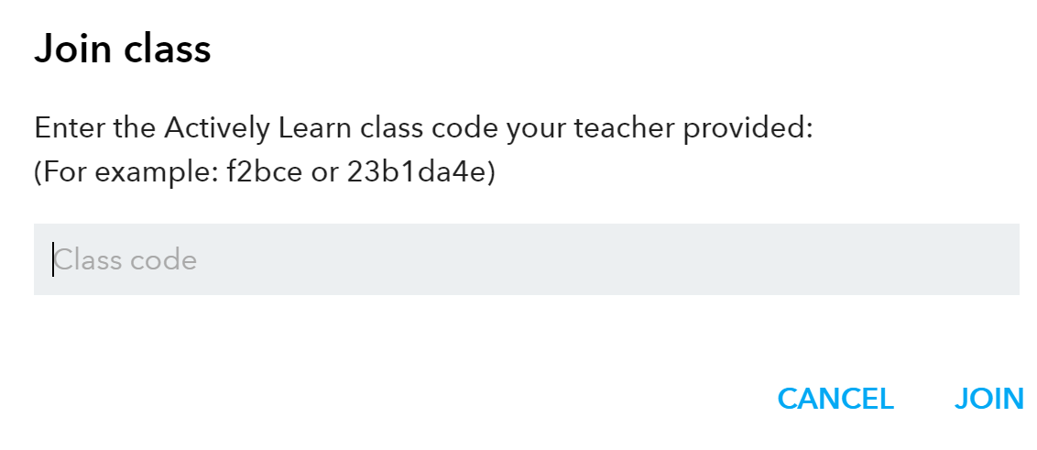
ADD CLASS
Click on + next to classes
Class Code: ENTER CODE

